Slide 1

Fund-raising
(Web Application)
Notes:
"Hello everyone, today I am excited to present our Fund-Raising Web Application. This platform is designed to make charitable giving more transparent, secure, and efficient for both organizations and donors."

Slide 2

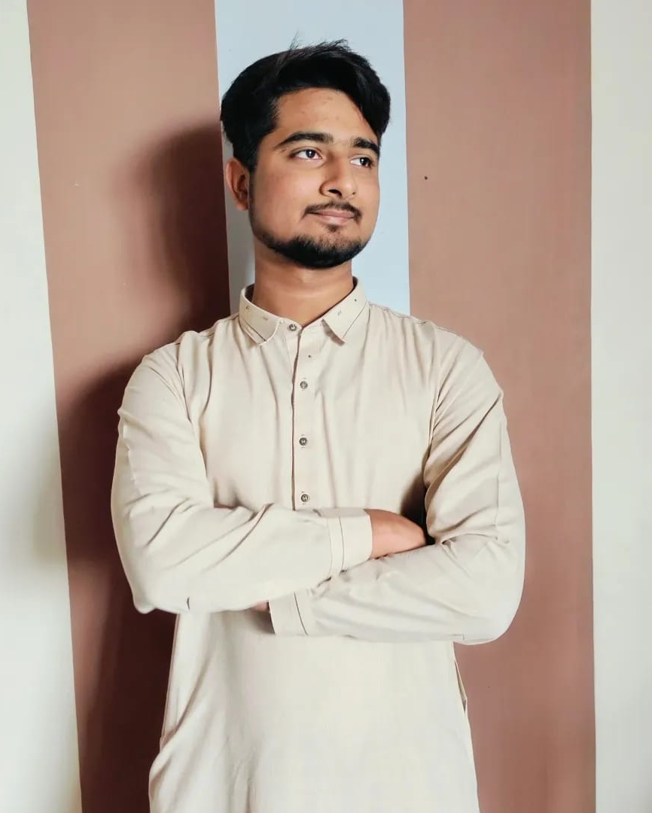


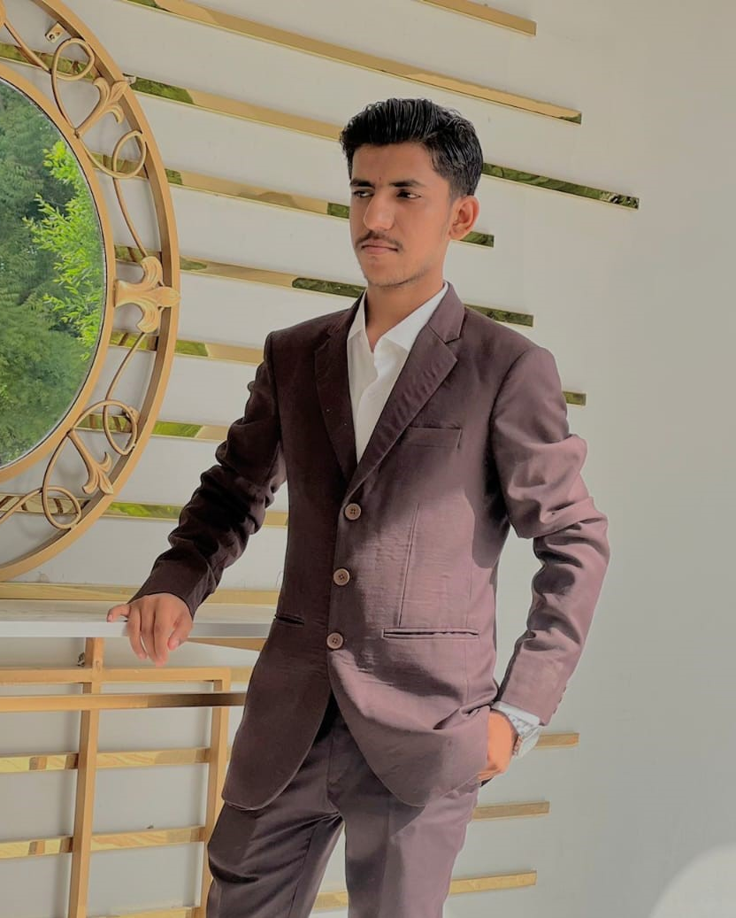
MEET THE LEADERSHIP TEAM
Muhammad Saif 22SW129
Abdul Rafay 22SW156
Fuzail Hussain 22SW132
Shoaib Ahmed 22SW126
full stack developer
Frontend Developer
Project Manager
Designer
As full-stack developer, I'll oversee the backend and front-end development to ensure a seamless user experience.
As Frontend Developer, I'll focus on creating an intuitive and visually appealing user interface.
As Project Manager, I'll manage timelines, and resources, and ensure smooth collaboration among the team.
As Designer, I'll design the layout and graphics, bringing creativity and aesthetic value to the platform.
“We, Muhammad Saif, Abdul Rafay, Fuzail Hussain, and Shoaib Ahmed, aim to create a robust and user-friendly web app through collaborative efforts. As MUET students, we are committed to making a difference. Join us in our mission to raise funds and turn this vision into reality!”
Fund-raising
Notes:
"Before diving into the details, let me introduce our leadership team. As a full-stack developer, I oversee both the frontend and backend to ensure a seamless user experience. Our designer focuses on creating a visually appealing layout. The frontend developer ensures an intuitive user interface, and our project manager keeps everything on track by managing timelines and resources."

Slide 3

Lack of Accountability: Donors are often asked to contribute via personal contacts, email requests, or through unverified channels like Google Forms and posters, making it hard to validate the legitimacy of the request.
Fraud Risk: With no formal verification, there’s a high chance of fraudulent requests slipping through, leading to donors unknowingly supporting illegitimate causes or scams.
Lack of Trust: The absence of an official, verified platform means donors are unsure whether their contributions will be used appropriately, leading to hesitation in donating.
Inefficiency in Fundraising: Organizations often struggle to create trustworthy and efficient channels for gathering donations, making it harder for them to reach potential donors.
THE ISSUE YOU'RE SOLVING
Notes:
"One of the biggest challenges in fundraising is trust and transparency. Many donors hesitate to contribute because they are unsure how their money will be used. Our platform addresses this issue by ensuring credibility through verification badges, clear fund tracking, and real-time updates from organizations."

Slide 4
Your submitted software and its functionality
Authentication
Secure Registration/Login
Users, organizations, and admins must create secure accounts through a registration process. Authentication ensures that only authorized individuals can post or manage funds.
Role-Based Access Control
Each user type (Admin, User, Organization) has different permissions and access levels within the application.
Fund-raising

Slide 5
Verifies and authenticates organizations before they can create fund-raising campaigns. Monitors the platform for potential fraudulent activities. Approves or disapproves campaigns based on verification and credibility.
Can browse and explore various fundraising campaigns by searching, sorting, and filtering. Can like, comment on, and share campaigns to raise awareness. Donates through secure, trusted payment channels and tracks donations via their personal account.
Can create and manage fundraising campaigns (e.g., post details about the cause, fundraising goals, updates). Must undergo an admin verification process before posting. Can collect donations through the platform, ensuring funds are directed to the verified cause.
Three Types of Users
USER
Fund-raising
Notes:
"Our platform caters to three types of users. First, donors who contribute to campaigns. Second, organizations that create fundraising campaigns and provide updates. Third, administrators who verify organizations and ensure transparency within the platform."

Slide 6

Create and Post Fund-Raising Campaigns: Only verified organizations can post campaigns, adding a layer of security and trust.
Campaign Details: Each campaign includes detailed information (e.g., cause, goal, timeline, updates) to ensure transparency.
User Interaction: Users can engage with campaigns by liking or sharing, promoting greater exposure and awareness.
Campaign Management
Fund-raising
Notes:
"Organizations can create and manage fundraising campaigns easily. They can set goals, upload proof of their legitimacy, and share updates on how the donations are making an impact. This feature ensures a structured and effective approach to fundraising."

Slide 7

Transparency and Security
Verification Badges
Verified organizations get special badges or tags to distinguish them from non-verified entities, ensuring credibility.
Donation Transparency
Donors can see how funds are being used and how much has been raised. Organizations can post updates about how donations are benefiting the cause.
Fund-raising
Notes:
"To build trust, we have implemented verification badges for organizations. These badges differentiate verified entities from non-verified ones. We also provide donation transparency, allowing donors to see how their funds are being used. Organizations can post updates, showing real-world impact."

Slide 8

Payment Integration
Secure payment gateways are integrated for safe financial transactions, ensuring that donations are processed securely.
Users can donate, without exposing there identity as we have made offline payment methods to keep users identity safe.
1
2
Fund-raising
Notes:
"For seamless donations, we plan to integrate secure payment options. Donors will have multiple ways to contribute, ensuring convenience and accessibility for all users."

Slide 9
An Overview of How It Was Created
Initial Concept & Problem Identification
Our team recognized the issue of fraud and inefficiency in the existing donation process, where verifying organizations and tracking donations was cumbersome.
We wanted to create an app that solved this problem by offering secure, verified donation channels while ensuring both donors and organizations had clear visibility and accountability.
Research & Ideation
We began with market research to understand the pain points of donors and organizations. This included interviewing potential users, non-profits, and charities.
Based on feedback, we defined the app’s core features: user roles, authentication, verified organizations, transparency in fund usage, and secure payment integration.
.
.
.
.
Fund-raising
Notes:
"Our development process followed a structured approach. We started with research and idea validation, then moved on to designing wireframes and prototyping before heading into development."

Slide 10
Prototyping & Development
We created a prototype to visualize how the app would look and feel for users and organizations.
The app was developed using React.js for the front-end (for responsive, interactive interfaces) and Node.js with Express.js for back-end services (to handle user authentication, database management, and campaign features).
We used MongoDB as the database to manage users, organizations, and campaigns.
Fund-raising
Notes:
"During this phase, we created initial designs, tested user flows, and built the core functionality of the platform. This step ensured that our application was both user-friendly and functional."

Slide 11

Testing & Refinement
The prototype was tested with a select group of users and organizations, collecting feedback on usability and functionality.
We iterated on the design and features, adding improvements like smoother navigation and enhanced security features for donations.
Fund-raising
Notes:
"We then conducted extensive testing, collecting user feedback and refining features to enhance security, usability, and performance."

Slide 12

Launch & Promotion
Once we were confident in the app’s stability, we launched the platform with an initial focus on social media marketing, email outreach, and partnerships with verified non-profits.
We also made use of SEO strategies to ensure that campaigns could be easily found by potential donors.
Fund-raising
Notes:
"After finalizing development, we focused on launching and promoting the platform. Our goal is to attract both organizations and donors, ensuring active participation and engagement."

Slide 13

Impact and Future Plans
Since its launch, the app has raised funds for numerous causes and continues to build a trustworthy community of donors and organizations.
We plan to continually improve the platform, integrating new features like mobile app versions, more payment options, and AI-powered campaign recommendations.
Fund-raising
Notes:
"Looking ahead, we plan to introduce additional features like AI-driven fraud detection, enhanced reporting tools, and expanded payment integrations. We aim to make this platform a go-to destination for trustworthy fundraising."

Slide 14

Conclusion
This fund-raising web application has been designed with the goal of creating a transparent, secure, and user-friendly platform for charitable giving. By ensuring organizations are verified and providing donors with complete transparency about their contributions, we are addressing the trust issues that often hinder charitable donations. Our app is a tool for good, and we’re excited to see how it evolves to make a difference in the world.
Fund-raising
Notes:
"In conclusion, our fund-raising web application is designed to make charitable giving transparent, secure, and impactful. By verifying organizations and keeping donors informed, we build trust and encourage meaningful contributions. Thank you for your time, and I look forward to your feedback!"

Slide 15

Thank You
Fund-raising

